Slide 1
Multi-Class Segmentation
In U-Net architecture,
by Sandu Cristian

Slide 2
Changes to the architecture:
This architecture is like the one presented in the Word Document.
As you could see, the U-Net was designed for only binary segmentation, where a maximum of one class is possible.
  To extend to multiclass functionality, on the final layer, we will force a channel for every class.

Slide 3
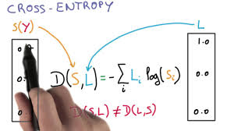
Okay, but how we will calculate the error?
Like in the binary case, we will use the Cross-Entropy function.
It would calculate the distance between two vectors. Our channel mask and our index
matrix.

Slide 4
How the results are interpreted?
Because, for multi-class segmentation, the training set is huge, (imagine, you need to train N output channels, to recognize features and to avoid overlapping).
Let’s say that the output, after the forward through the matrix, has format: Output[channels][height][rows]. We need to reconstruct the masked for the image, so we will select the maximum value from the channels, on the same image locations.

Slide 5
But it is working?
Well, training data for multi-class is huge. Imagine, we need to train N more convolutions, to classify the image. And this is not the only problem, we need to check to make the desired feature stronger, to go in front.
So, in to validate if the architecture works, I start by overfitting the system on a small given set of images, with many epoch.
After the overfitting, the system should be able to successfully classify the given image, and…

Slide 6
Augmentation of Input. Reduce complexity
I used the bdd100k database. (the name is suggestive)
There are 32 classes, I am almost sure that the U-Net won’t handle this number, in this configuration (too few number of channels, to extract the needed features). I want results fast, so I can not spend 2 days on the training process.
So, I decided to combine data, into general classes, e.g: (next slide) Reducing its complexity will help. In this way, I can train the network on a smaller number of samples.

Slide 7
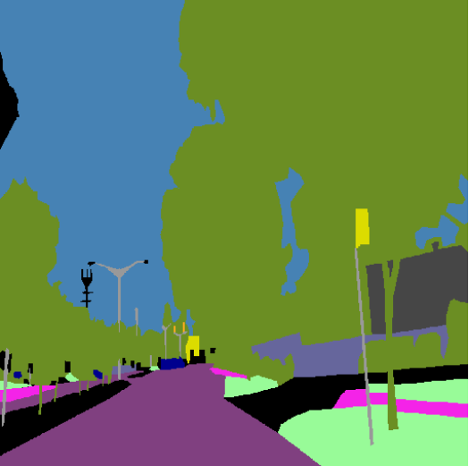
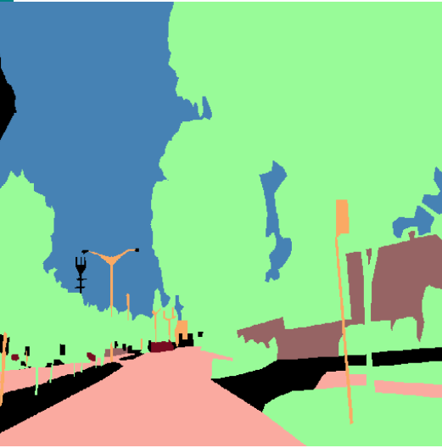
And here are the augmentation examples:

Slide 8
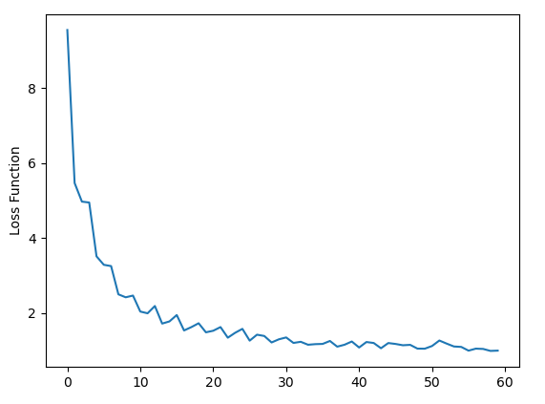
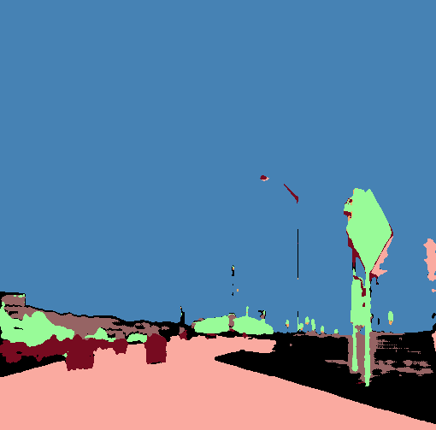
Testing with Overfitting:
Configuration:
  20 sample of similar data, take in random order for each epoch
  20 epoch
  Batches of 2 images

Slide 9
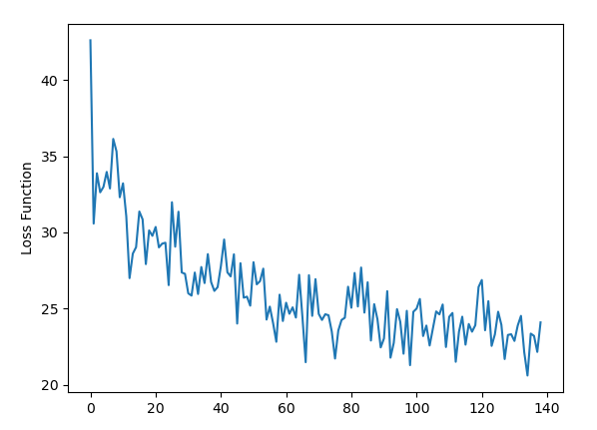
Testing on 8k images
Took almost 3-4h. So, testing on 100k images, it should take 3 * 100/4 approx. 30h?
Results?

Slide 10
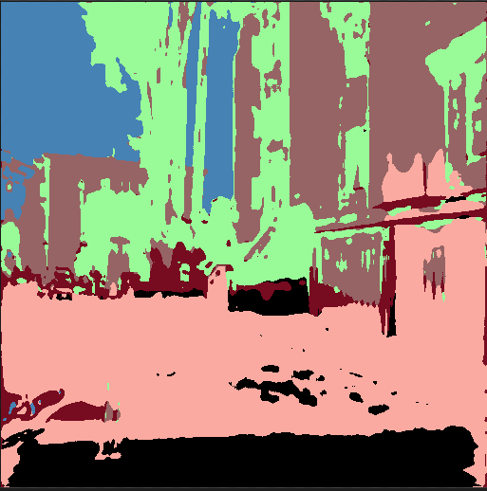
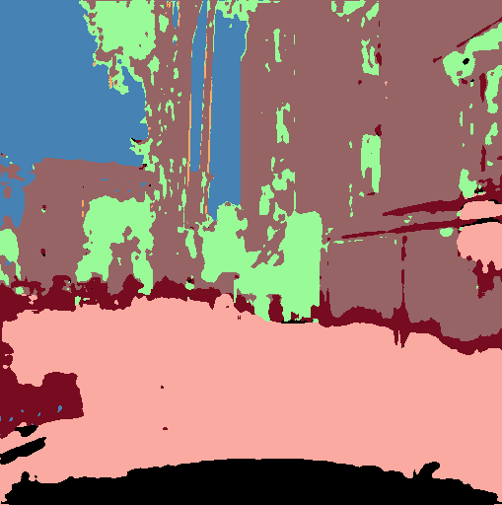
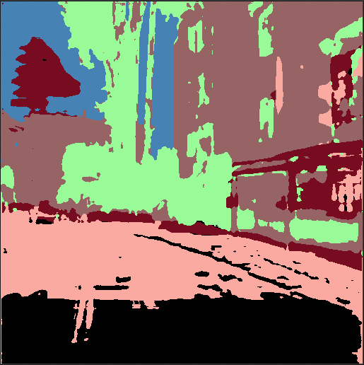
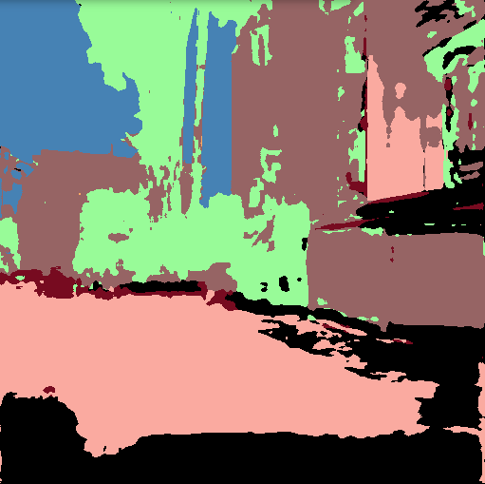
Results! (after 8k)
500 batches 1k batches 2k batches 4k batches

Slide 11
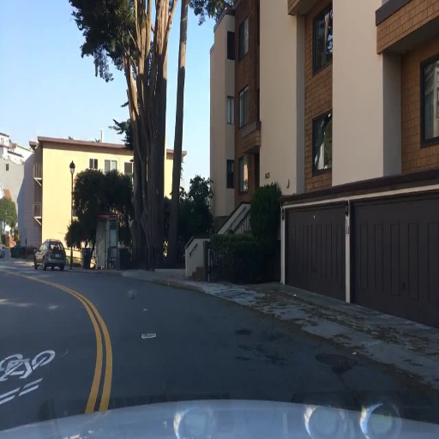
Original Image

